Slide 1

PROPOSAL
MMKSI
NEW HRD SYSTEM
Proposed to:​
PT Mitsubishi Motors Krama Yudha Sales Indonesia
(MMKSI)​
Attn:
Mr. Takahiko Sato (Director – Finance)
Mr. Jumpei Oki (EGM – Finance)
Mr. Sapto H. Ary B. (Dept head – IT)
26 March 2026
Proposal No: 001/PROP.BSI/AOI/IV/26

Slide 2
Table of Content
1.
Executive Summary
2.
Requirement and Propose Solution
3.
Project Methodology
4.
Project Organization Structure
1.1 Background
1.2 Objective
1.3 Benefit
1.4 Commercial Overview
2.1 Functional Requirement
2.2 Non-functional Requirement
2.3 System Architecture
3.1 Project Approach
3.2 Project Event
3.3 Project Phase/Timeline
4.1 Project Organization
5.
Commercial
6.
Approval
5.1 Implementation Fee
5.2 Operation Fee
5.3 Four Years TCO
5.4 General Term Condition
BSI

Slide 3
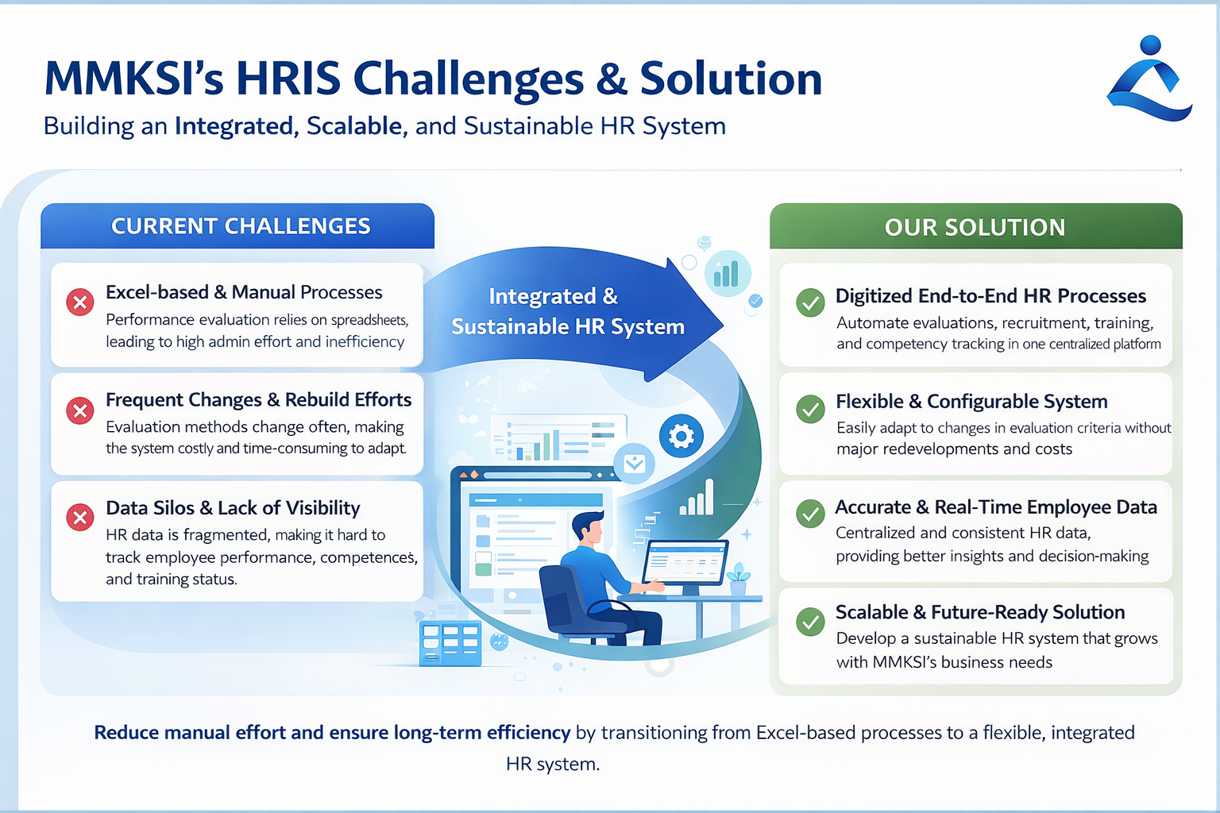
BSI
Notes:
Configurable vs adaptive changes according to business needs Ensure existing BSI framework microservices implemented on this project (DevLead required to ensure secure development implemented)

Slide 4
1. Executive Summary
1.1 Background
Currently, MMKSI’s HRD Processes are largely managed using Excel, covering form creation, evaluation execution, and result aggregation. This manual approach leads to inefficiencies, high administrative effort, and challenges in maintaining data consistency.
1.2 Objective
Digitize and streamline the current Excel-based HR processes into a centralized system
Provide a flexible and configurable system that can adapt to changing evaluation methods
Reduce manual effort and administrative workload in HR operations
Establish a scalable and sustainable HR system to support long-term business needs
1.3 Benefit
Reduced dependency on manual Excel processes, improving efficiency and accuracy
Lower long-term cost and effort through a configurable and adaptable system
Consistent and reliable HR data as a single source of truth
Improved process control and visibility across evaluation and HR activities
Scalable solution that supports future organizational changes
1.4 Commercial Overview
Implementation Fee (IDR) : 1,920,000,000 FY26 Operation Fee (IDR) : 135,000,000
BSI

Slide 5
2. Requirement & Propose Solution
2.1. Functional Requirement
BSI proposes the implementation of a new HRD system designed with a strong focus on usability, process alignment, and scalability. The solution will be configured based on validated HRD pain point, requirements and best practices to ensure long-term value and adaptability.
Module | Pain Point | Propose solution* | Benefit
Performance Evaluation | Misaligned and inconsistent performance evaluations | Provide a system function that enable structured and end-to-end Performance Evaluation process starting from individual KPI planning that align with company goals. | Operational efficiency to support Data-driven decisions.
Logbook | Inefficient, error-prone logbook management. | Implement a centralized Logbook & Competency Management System that enables structured competency tracking, automated data capture, and real-time visibility across employees and departments. | Drive operational efficiency with automated processes, ensure accurate and consistent competency data, and enable real-time insights for faster, more informed decision-making.
Promotion | Manual, fragmented promotion process having lacking transparency, consistency, and data traceability. | Centralized data which automatically pulls in real-time employee metrics (performance scores, tenure, attendance) into a single evaluation profile. | Provides a clear, documented audit trail of the entire decision-making process for compliance and employee feedback.
*) Detail Requirement provided in Appendix.
BSI
Notes:
Summarize content and make simplify

Slide 6
2. Requirement & Propose Solution
2.1. Functional Requirement
Module | Pain Point | Propose solution* | Benefit
Manpower Planning | Relying on informal communication channels for staffing requests makes it difficult to consolidate company needs and accurately visualize department staffing levels or turnover rates. | Implementing a standardized, system-based workflow streamlines headcount requests through structured forms with approval routing. | Establishing a single source of truth eliminates messy spreadsheets, ensuring HR, management, and department heads are perfectly aligned on the exact same data.
Training Management | Manual training process and tedious administrative tasks. Additionally scattered paper-based records make it highly difficult to map employee competency gaps and track critical training statuses. | A centralized digital platform streamlines HR operations, housing all training histories, transitioning evaluations entirely online, and linking training modules to performance logs allows the system to automatically calculate scores and suggest tailor courses to relevant employee | The system frees HR to focus on strategic talent development and curriculum planning. It also providing management with real-time visibility into overall training effectiveness.
Master Data Configuration | Utilize Excel spreadsheet in storing data introduces a significant risk of data discrepancies and mismatched data information | Implementing a centralized, secure database establishes as single source of truth for all organizational and employee records. | Ensures all future modules you build on top (Promotion, Recruitment, Performance) will pull from 100% accurate, real-time data.
*) Detail Requirement provided in Appendix.
BSI

Slide 7
2. Requirement & Propose Solution
2.1. Functional Requirement
Module | Pain Point | Propose solution* | Benefit
Job Profiling | The lack of a job posting system often results in inconsistent branding, fonts, and layouts across public-facing job postings. Furthermore, the difficulty of manually tracking these postings often leaves filled or expired roles active on the website, confusing potential candidates. | Utilizing pre-configured templates and automated schedule to automatically maintain consistent corporate branding and automatically taking them down once application deadlines pass or quotas are met. | Ensuring guaranteed brand consistency creates a highly professional and uniform look for all open roles Automated significantly improving the browsing experience for potential applicants.
Recruitment | Disconnected candidate data sources and a fragmented recruitment results in the loss of top talent. This problem also create significant risks with Personal Data Protection (PDP) standards and internal company compliance policies. | Implementing an integrated recruitment management system which streamlines the entire end-to-end hiring process | Optimizing the recruitment process significantly increases cost efficiency when sourcing potential candidates.
*) Detail Requirement provided in Appendix.
BSI

Slide 8
2. Requirement & Propose Solution
2.2. Non-Functional Requirement
Non‑Functional Area | Non‑Functional Requirement Description | Solution Provision
Usability & User Experience | The system must be easy to use, intuitive, and require minimal training to ensure high adoption by HR users, managers, and employees. | The solution provides a user‑centric interface with simplified navigation, role‑based screens, and consistent user experience across all HR modules.
Availability & Reliability | The system must be reliably accessible during business hours with minimal system downtime to support critical HR operations. | The solution is deployed on a stable infrastructure with high availability configuration and defined maintenance windows.
Performance | The system must respond quickly for daily HR operations such as evaluations, approvals, and reporting, even during peak usage periods. | The solution is designed to support concurrent users with optimized processing and response time for core HR activities.
Scalability | The system must support future growth in number of employees, organizational changes, and additional HR processes without major redesign. | The solution uses a modular and scalable architecture that can accommodate organizational growth and additional functionalities.
Security & Data Protection | The system must protect sensitive employee data and ensure access is strictly controlled according to user roles. | The solution enforces role‑based access control, secure authentication, and data protection mechanisms aligned with corporate security standards.
BSI

Slide 9
2. Requirement & Propose Solution
2.2. Non-Functional Requirement
Non‑Functional Area | Non‑Functional Requirement Description | Solution Provision
Auditability & Compliance | The system must provide audit trails and approval logs to support internal governance, compliance, and review processes. | The solution records all key actions, approvals, and changes with timestamped audit logs accessible to authorized users.
Configurability | The system must be configurable to support policy changes, workflow adjustments, and organizational structure updates without custom development. | The solution allows authorized HR administrators to configure workflows, evaluation stages, forms, and approval hierarchies.
Integration Capability | The system must be able to integrate with existing HR, payroll, and communication systems to ensure data consistency. | The solution supports integration with HR master data, recruitment microsites, notification services, and other enterprise systems.
Reporting & Visibility | The system must provide clear dashboards and reports to support monitoring, decision‑making, and management review. | The solution delivers role‑based dashboards and exportable reports for HR, management, and BOD visibility.
BSI

Slide 10
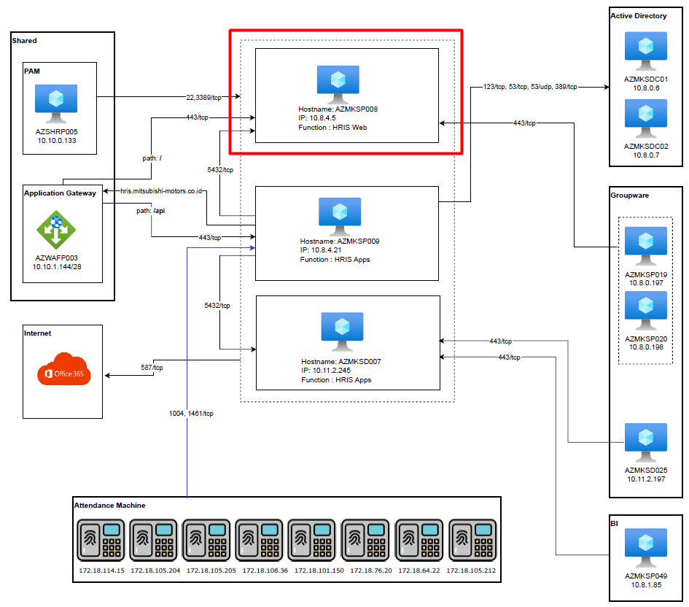
2. Requirement & Propose Solution
2.3. System Architecture
System architecture on this project will use existing environment implemented on MMKSI HRM system with the following specification:
BSI

Slide 11
2. Requirement & Propose Solution
2.3. System Architecture
System architecture on this project will use existing environment implemented on MMKSI HRM system with the following specification:
BSI

Slide 12
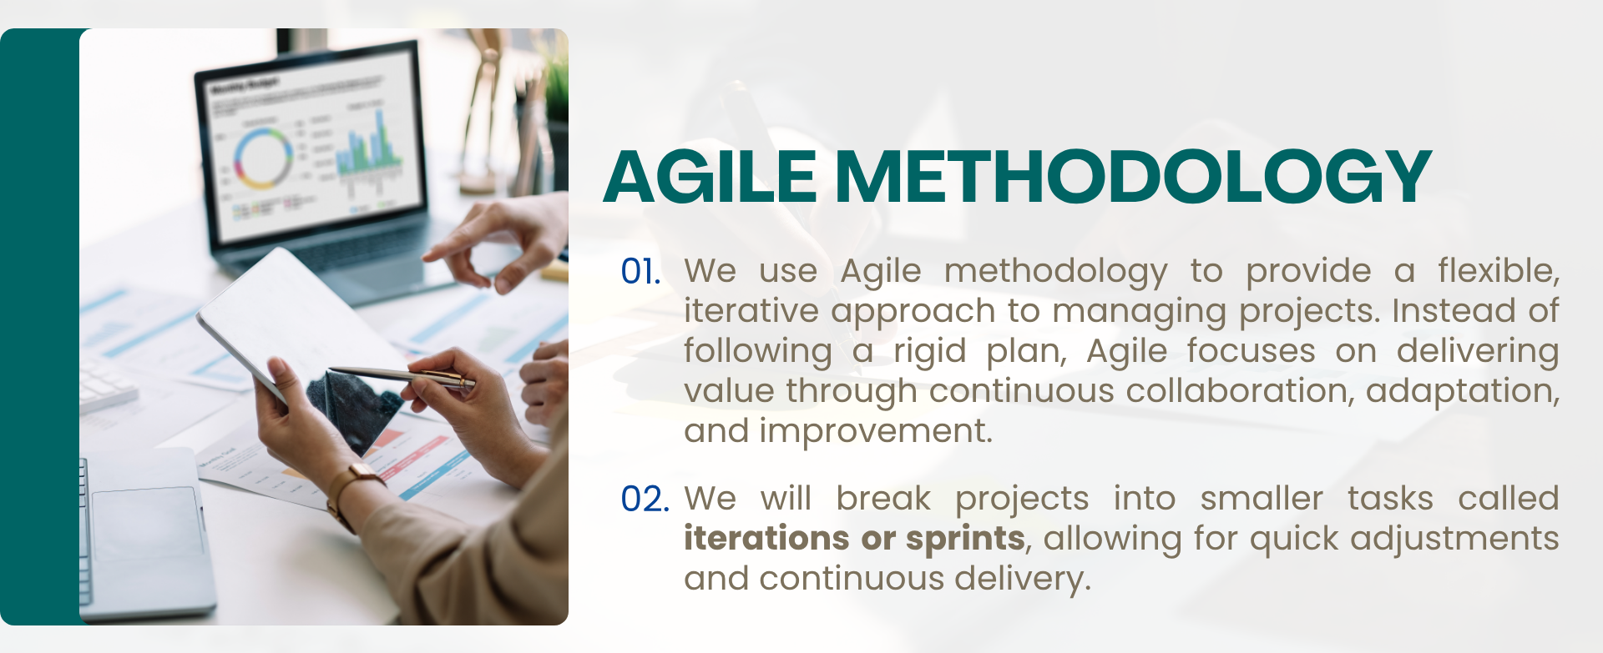
3. Project Methodology
3.1 Project Approach
BSI

Slide 13
3. Project Methodology
3.2. Project Event
Pre PI Planning
PI Planning
Iterations 1
Daily Stand Up
Iteration Planning
Backlog Refinement
Iteration Review
Iteration Retro
Iterations (n)
Daily Stand Up
Notes:
PI: Program Increment
CAB: Change Advisory Board VAPT: Vulnerability Assessment and Penetration Testing
Iteration Planning
Backlog Refinement
Iteration Review
Iteration Retro
Release Preparation
UAT
Code Review
Regression Test
VAPT
Event that need MMKSI Key Users involvement
Deployment
CAB 2
Remediation
BSI

Slide 14
3. Project Methodology
3.3 Project Phase/Timeline
The project phase outlines the key timeline and milestones for successful completion.
Apr 26 | May 26 |  | Jun 26 |  | Jul 26 |  | Aug 26 |  | Sep 26 |  | Oct 26 |  | Nov 26
 | Iteration 1 | Iteration 2 | Iteration 3 | Iteration 4 | Iteration 5 | Iteration 6 | Iteration 7 | Iteration 8 | Iteration 9 | Iteration 10 | Iteration 11 | Iteration 12 | Iteration 13 | Iteration 14
Enabler
Development Iteration
Development 1st Backlogs :
Master Data configuration
Performance Evaluation
Master data migration
Training Activity
Partial Go Live with limited access using VPN
Development 2n^{d} Backlogs:
Logbook Promotion
Development 3rd Backlogs: Training Management
Development 4th Backlogs:
Man-Power Planning (MPP)
Recruitment
Go live and Preparation: 1. VAPT
2. Training
3. Release
Enabler activities : 1. Prepare development environment
2. Resources preparation
Partial Go Live 1 (W4 Jun 26)
Full Go-Live (W2 Nov 26)
Start Operation Partial Go live 1
Key User Training will be provided for training activity
This timeline can be more shorten or become longer, depends on scope items review result on each iteration time (2 Weeks). ​
Any adjustment on priority based on MMKSI request is welcome within agile methods, while scope remains controlled.
MMKSI will review product backlog incremental progress through iteration demo meeting every biweekly.​
PDCA review must be conducted during operation after partial 1st go live.
Every new potential improvement (output from PDCA Result) can be put as additional product backlog and put on development chain activity based on decision from MMKSI to absorb it or not.​
BSI

Slide 15
3. Project Methodology
3.3 Project Phase/Timeline
The project phase outlines the key timeline and milestones for successful completion.
Apr 26 | May 26 |  | Jun 26 |  | Jul 26 |  | Aug 26 |  | Sep 26 |  | Oct 26 |  | Nov 26
 | Iteration 1 | Iteration 2 | Iteration 3 | Iteration 4 | Iteration 5 | Iteration 6 | Iteration 7 | Iteration 8 | Iteration 9 | Iteration 10 | Iteration 11 | Iteration 12 | Iteration 13 | Iteration 14
Enabler
Development Iteration
Development 1st Phase:
Master Data configuration
Performance Evaluation (PMF)
Master data migration
Go live Prep.: 1. UAT
2. KUT
3. Code Review
4. Release
Development 2n^{d} Phase:
Manpower Planning (MPP)
Promotion
LogBook
Go live Prep.: 1. UAT
2. KUT
3. Code Review
4. Release
Development 3rd Phase:
Training
Recruitment
Job Profile
Go live and Prep.: 1. UAT
2. KUT
3. Code Review
4. VAPT
5. Release
Enabler activities : 1. Prepare development environment
2. Resources preparation
Partial Go Live 1 (W4 Jun 26)
Partial Go Live 2 (W2 Sep 26)
Full Go-Live (W4 Nov 26)
Start Operation Partial Go live 1
Key User Training will be provided for training activity
This timeline can be more shorten or become longer, depends on scope items review result on each iteration time (2 Weeks). ​
Any adjustment on priority based on MMKSI request is welcome within agile methods, while scope remains controlled.
MMKSI will review product backlog incremental progress through iteration demo meeting every biweekly.​
PDCA review must be conducted during operation after partial 1st go live.
Every new potential improvement (output from PDCA Result) can be put as additional product backlog and put on development chain activity based on decision from MMKSI to absorb it or not.​
BSI

Slide 16
4. Project Organization Structure
4.1 Project Organization
Steering Committee
MMKSI: Mr. Mr. Takahiko Sato / Mr. Wisnu Wardhana
BSI: Mr. Takahiro Ataku / Ms. Wijayanti Govindaraju
Project Director
MMKSI: Mr. Bambang Sugeng /
Mr. Sapto H. Ary B BSI: Mr. Asra Haryadi
Project Support
Project Manager
PMO: Mr. Tito Tamaro Sales: Mr. Donnie Adilaksono
Solution Architect: Afif Junihar Fakri
Infra team : TBC
Product Management
MMKSI: Mr. M. Hidayat
BSI: Mr. Budi ITD: Denni Ferianto
Product Manager: Mr. Harli Christian Rizky
Agile Team
Key Users
Scrum Master: Mr. Rakha Agung
Product Owner: Mr. Andi Darmansyah Developer Lead: Bambang Puji Basuki Developer: Developer Team UI/UX: Mr. Rafiyan Dwi Putra
MMKSI HRD: 1. Mr. James Victorio Ade W.
2. Mr. Chrisna Cahya Nugraha
3. Ms. Anggit Nurmalita Sari
4. Ms. Nurul Khalisah
BSI
Notes:
Please ask to Taka-san

Slide 17
5. Commercial
5.1. Implementation Fee
Below are MMKSI HRD New System service fee:
Description | Amount (IDR)
Implementation Fee System Development API Development with existing system VAPT Remediation | 1,853,900,000
Vulnerability Assessment & Penetration Testing (VAPT) | 66,100,000
Total Amount | 1,920,000,000
Terms and Condition
Prices are in Indonesian Rupiah (IDR) and exclude VAT
MMKSI should deduct withholding Tax.
The prices are valid for 2 weeks from the Proposal is sent to MMKSI.​
Any additional or change of requirement which will be impacted to effort, cost, milestone, or schedule, will be charged as change request and will be treated as Engineering Change Proposal (ECP).​
MMKSI New HRD System implementation shall be started after the approved proposal is received by BSI.​
Payment Terms:
1st payment : 50% after this proposal is approved by MMKSI
2nd payment : 50% will be invoiced after Project closing report signed by MMKSI
BSI

Slide 18
5. Commercial
5.2. Operation Fee
Below is the summary of effort estimation that is required in Operation & Maintenance (O&M) after each GoLive.
If the project schedule is changed due to any reasons, the estimation can be changed accordingly.
No​ | Service Name​ | HR Operation Amount FY26 (in Mio IDR) |  |  |  |  |  |  |  |  |  |  |  | (FY27)​
 |  | May’​ 26 | Jun’​ 26 | Jul’ ​ 26 | Aug’​ 26 | Sep’​ 26 | Oct’​ 26 | Nov’​ 26 | Dec’​ 26 | Jan’​ 27 | Feb’​ 27 | Mar’​ 27 | Total​ | Monthly​
Milestone​ |  | ​ | ​ | ​ | ​ | ​ | ​ | ​ | ​ | ​ | ​ | ​ | ​ | ​
1​ | Existing ​HRIS O&M HR & SW Cloud | 42.4 15.04 | 42.4 15.04 | 43.73 15.04 | 43.73 15.04 | 43.73 15.04 | 43.73 15.04 | 43.73 15.04 | 43.73 15.04 | 43.73 15.04 | 43.73 15.04 | 43.73 15.04 | 478.37 165.44 | 44.48​ 15.04
2​ | New HRD O&M (HR)* | 0​ | 0​ | 9 | 9 | 9 | 9 | 9 | 22.5 | 22.5 | 22.5 | 22.5 | 135 | 22.5
Total Amount Estimation​ |  | 57.44 | 57.44 | 67.77 | 67.77​ | 67.77 | 67.77 | 67.77 | 81.27 | 81.27 | 81.27 | 81.27 | 778.81 | 82.02
Go-Live 1
Full Go-Live
*) detail activities on appendix
Terms and Condition
Prices are in Indonesian Rupiah (IDR) and exclude VAT
This operation service shall be started after first Go Live is being released
Above price table is refer to defined scope of service in Appendix - I
Service period for HRIS Managed Service is 1 year starting from go live date. If MMKSI terminates the Service before the end of the Service Period, MMKSI shall compensate BSI in amount of remaining Service Period left.
Any additional scope of work that is not stated in this document will be charged in separate invoice based on relevant supporting document.
BSI

Slide 19
5. Commercial
5.3. 4 Years TCO
Below are figure of Total Cost Ownership (TCO) with 4 years period (in IDR)
Item | FY 2026 | FY 2027 | FY 2028 | FY 2029 | FY 2030 | Grand Total
Development Fee | 1,920,000,000 |  |  |  |  | 1,920,000,000
Operation Fee | 135,000,000 | 270,000,000 | 270,000,000 | 270,000,000 | 135,000,000 | 1,080,000,000
VAPT |  | 19,700,000 | 19,700,000 | 55,800,000 | 19,700,000 | 114,900,000
Total Fee | 2,055,000,000 | 289,700,000 | 289,700,000 | 325,800,000 | 154,700,000 | 3,114,900,000
Notes:
TCO period start Aug ‘26 ends on Jul ‘30
The first VAPT will be conducted in FY26 and is included in the proposal. In accordance with MC regulations, VAPT is required to be conducted once every three years; therefore, the second VAPT will be conducted in 2029. In the intervening years, only a Website Vulnerability Assessment is required.
BSI

Slide 20
5. Commercial
5.4. General Terms and Condition
The following are the terms and conditions ("The Terms and Conditions") on which BSI shall provide the services to MMKSI set out in the quotation/order form. The quotation/order form and the Terms and Conditions are together referred to as "The Agreement".
The agreement forms the entire agreement between the parties relating to the Services. It replaces and supersedes any previous proposals, correspondence, understandings or other communications whether written or oral.
In the event of a conflict between the provisions in the Terms and Conditions and the quotation / order form, the quotation / order form shall prevail.
Payment conditions:
1.1. The prices for the provision of the services are set out within the quotation / order form.
1.2. In the event MMKSI required additional support and / or services from BSI during project execution, other than the agreed support by BSI based on this quotation / order form, BSI shall charge with BSI standard man hour or man day rate. That will be informed later to MMKSI for the service fee.
1.3. The invoice due date is 30 (thirty) calendar days after it is received by MMKSI, and directed to:
A/C PT. BERLIAN SISTEM INFORMASI
MUFG Bank Ltd, JAKARTA BRANCH, INDONESIA
SWIFT Code : BOTKIDJX
Account No (IDR) : 5100 129149
1.4. If MMKSI have not paid BSI up to the due date, BSI shall submit dunning letter to MMKSI.
1.5. If within 14 (fourteen) days after the date of the dunning letter, MMKSI have not paid the price to BSI, MMKSI shall be liable for a late charge in amount of 0.1% of the price per day of lateness.
BSI

Slide 21
5. Commercial
5.4. General Terms and Condition
2. Intellectual Property Rights
2.1. BSI warrants that the software delivered to MMKSI already furnished with the proper licenses.
2.2. Upon the delivery of the software from BSI to MMKSI, BSI shall not be liable to any infringements conducted by MMKSI related with the intellectual property rights contained in the hardware and software.
3. Miscellaneous
3.1. This agreement shall be construed and governed under the law of the Republic of Indonesia.
3.2. Everything has not yet been stipulated in this agreement shall be decided mutually by the parties in the form of correspondence, amendment and addendum, and become an integral part with this agreement.
BSI

Slide 22
6. Approval
Signed on behalf of PT Berlian Sistem Informasi (BSI)
Signed on behalf of PT Mitsubishi Motors Krama Yudha Sales Indonesia (MMKSI)
By:
 | (Signed)
Name : | Mr. Takahiro Ataku
Tittle : | Director
Date :
By:
 | (Signed)
Name : | Mr. Takahiko Sato
Tittle : | Director
Date :

Slide 23
Appendix

Slide 24
I. Detail Functional Requirement & ID
No | Requirement
Master Data Configuration
1 | CR-001: The system must provide a bulk upload feature for CRUD (Create, Read, Update, Delete) activities CR-002: The system must have an approval mechanism based on employee needs CR-003: The system must align employee information from HR and be able to send notifications via WhatsApp
Performance Evaluation
2 | PE-001: The system shall provide three stages of Performance Evaluation (Planning, Mid-Year, and End-Year). PE-002: The system shall allow the creation of KPI banks per job position and/or manual KPI entry. PE-003: The system shall allow users to define Performance Evaluation periods. PE-004: The system shall assign supervisors based on organizational structure and/or manual configuration. PE-005: The system shall link individual KPIs with company level and division-level targets. PE-006: The system shall provide a complexity matrix or KPI subclassification to define KPI weighting. PE-007: The system shall allow HR to configure concurrent supervisors at the same level. PE-008: The system shall allow adding and editing targets at each Performance Evaluation stage. PE-009: The system shall provide a revise option during the Performance Evaluation review process. PE-010: The system shall provide adjustable final scoring for calibration results
Logbook
3 | LB-001: The system should provide features for Logbook LB-002: The system shall provide Competency Dictionary also with proficiency level description as guidance for employees. LB-003: The system should provide adjustable Logbook Form LB-004: The system shall connect the evaluator to organization structure and/or manually added LB-005: The system shall provide list of employees at managerial level in logbook module LB006: The system shall be possible to add assessment center result for specific class and become consideration for assessment result

Slide 25
I. Detail Functional Requirement & ID (Cont’d)
No | Requirement
Promotion
4 | PR-001: The system shall provide Promotion Evaluation based on current regulation PR-002: The system shall connect to HRM module, Promotion Evaluation History, Bonus Evaluation History, Attendance Report, Logbook Result, Training Attendance PR-003: The system shall let evaluator put Evaluation (Performance and Personality) as consideration to Promotion Evaluation PR-004: The system shall calculate the result of Promotion Evaluation History, Bonus Evaluation History, Attendance Report, Logbook Result, Training Attendance PR-005: The system shall automatically update the organizational structure based on promoted employees PR-006: The system shall automatically update the organizational structure based on employee rotations or concurrent (dual) assignments
Training Management
5 | TC-001: The system must allow HR to schedule and record new employee inductions TC-002: The system shall be able to connect data from the evaluation of promotion and rotation (talent movement) as source for employee training plan TC-003: The system shall provide Training Need Analysis (TNA) form TC-004: The system shall provide approval system for TNA that connects with organization structure and/or manually added TC-005: The system shall provide training requests other than TNA, Logbook evaluation, Talent movement TC-006: The system shall summarize training needs from TNA, Logbook, Talent movement and link to employee profile as development plan TC-007: The system shall trigger training completion after employee submits training attendance TC-008: The system shall provide training evaluation form as a part of training implementation process TC-009: The system shall be able to record sharing session implementation as a part of training completion process TC-010: The system must be able to record HR Training Programs (specifically for mandatory training, not those requested by employees)

Slide 26
I. Detail Functional Requirement & ID (Cont’d)
No | Requirement
Manpower Planning
6 | MPP-001: The system shall enable authorized users to initiate and manage customizable Regular and Incidental Manpower Planning & Placement (MPP) MPP-002: The system shall enable authorized users to securely submit validated MPP requests during configurable departmental periods, automatically routing them through designated HR and BOD approval workflows MPP-003: The system shall dynamically adapt form fields, approval workflows, and organizational data validation based on configurable MPP requests. MPP-004: The system shall provide a real-time, configurable dashboard with role-based access that enables authorized users to visibly track, filter, and export the status of all MPP requests across their approval workflows. MPP-005: The system shall route validated MPP requests through a customizable, multi-tier approval workflow featuring editable routing recommendations and mandatory BOD authorization. MPP-006: The system shall process rejected MPP requests by either routing them back to the user for modification under a "Revision Required" status or permanently closing them as "Not Needed," while automatically dispatching detailed notifications that include reviewer feedback and actionable next steps. MPP-007: The system automatically updates MPP data in real-time across the user dashboard upon any workflow change, providing requestors and Division Heads with immediate visibility into current statuses, reviewer feedback, and required actions, supported by automated notifications MPP-008: The system enables users to submit Incidental MPP Requests outside the regular annual cycle using the standard form and approval workflow. MPP-009: The system shall automatically notify HR upon MPP request submissions and seamlessly route reviewed requests to the BOD for approval. MPP-010: The system shall enforce configurable, role-based access for MPP request reviews, enabling the BOD to approve, reject, or mandate revisions.

Slide 27
I. Detail Functional Requirement & ID (Cont’d)
No | Requirement
Job Profile
7 | JP-001: The system shall enable authorized users to securely draft, edit, and submit standardized Job Description and Job Requirement forms that integrate directly with the MPP module, ensuring all created vacancies strictly align with approved workforce plans. JP-002: The system shall enable HR Admins and Hiring Managers to submit mandatory Job Description and Requirement forms that are validated, tracked via audit trails, and reviewed before entering the recruitment pipeline. JP-003: The system shall provide a secure login for candidate authentication. JP-004: The system shall enable authenticated candidates with completed profiles to seamlessly apply for and track multiple distinct vacancies using synchronized ATS data. JP-005: The system should provide authenticated candidates with a secure, MMKSI-formatted online application form supporting saved drafts and document uploads, seamlessly integrating validated submissions into the ATS. JP-006: The system enables authorized HR personnel to dynamically configure candidate application form fields and seamlessly synchronize these updates across the microsite and ATS.
Recruitment
8 | RC-001: The system shall enable authorized HR personnel to efficiently execute validated bulk candidate stage movements that automatically trigger subsequent ATS workflows and update dashboards in real-time. RC-002: The system shall provide push notification to candidate, user or any stakeholder that is involved in recruitment process to their email and account RC-003: The system shall use data from microsite to show list of candidates RC-004: The system shall allow HR to assign test case to candidate email directly and shown in their credential login (Account) RC-005: The system shall allow HR to submit HR Interview results and embed in candidates profile RC-006: The system shall allow HR to submit Psychological Test result and embed in candidate profile RC-007: The system shall allow HR to arrange user interviews and push requests to user (any level) to approve regarding the arrangement RC-008: The system shall allow User to submit the result of User Interview and give decision passed/not passed

Slide 28
I. Detail Functional Requirement & ID (Cont’d)
No | Requirement
Recruitment (Cont’d)
8 | RC-009: The system shall allow HR to arrange MCU for candidates with stakeholders (Payroll & Welfare) RC-010: The system shall allow HR to submit MCU results and embed them in candidate profile RC-011: The system shall allow HR to summarize candidates who have passed all stages and subsequently request BOD approval for offering RC-012: The system shall allow BOD to approve proposed candidates RC-013: The system shall allow HR to push email to GA, IT, and HR group to provide new employee needs RC-014: The system shall enable the recording of the first-month probation evaluation for future review RC-015: The system shall allow HR to issue final decision letters (Pass/Fail) RC-016: The system shall send automatic reminders before monthly evaluation deadlines. RC-017: The system should provide dashboards for monitoring recruitment processes.

Slide 29
II. Decision Analysis Result
I. Decision Matrix
No | Criteria | Weight Percentage | SUNFISH |  | SPISY |  | TAILORED SOLUTION
 |  |  | Score | Weighted Score | Score | Weighted Score | Score | Weighted Score
1 | Functional Requirement | 40% | 4.82 | 1.93 | 5.00 | 2.00 | 5.00 | 2.00
2 | Non-Functional Requirement | 30% | 4.80 | 1.44 | 4.20 | 1.26 | 3.90 | 1.17
3 | Implementation and Operation | 30% | 3.00 | 0.90 | 3.50 | 1.10 | 3.90 | 1.22
 |  | 100% | - | 4.27 | - | 4.36 | - | 4.39
 | FINAL RANK |  |  | 3 |  | 2 |  | 1
 |  |  | SUNFISH |  | SPISY |  | TAILORED SOLUTION
 | Implementation |  | IDR 5,615,390,000 |  | IDR 2,607,100,000 |  | IDR 1,927,800,000
 | Operation |  | IDR 590,357,000 |  | IDR 383,000,000 |  | IDR 270,000,000
 | Total |  | IDR 6,205,747,000 |  | IDR 2,990,100,000 |  | IDR 2,197,800,000

Slide 30
II. Decision Analysis Result
II. Decision Analysis Result Conclusion
Based on DAR, Tailored Solution is the recommended solution for HRD MMKSI.
The decision is based on the following strategic advantages:
Based on Functional Requirement Tailored Solution is capable of meeting all functional requirements requested by the user, ensuring no operational gaps.
Based on Implementation & Operation
Cost-Efficiency: The most competitive pricing structure available.
Unrivaled Customization: Flexibility that outperforms all alternative solutions.
Total Scalability: An unlimited licensing scheme with zero restrictions on user count.
Dedicated Support: A premium support ecosystem accessible to MMKSI at any time.

Slide 31
III. Proposed Flow Process
I. Proposed Process Flow – Performance Evaluation
Here is the business process of Performance Evaluation:

Slide 32
III. Proposed Flow Process
II. Proposed Process Flow – Logbook
Here is the business process of Logbook:

Slide 33
III. Proposed Flow Process
III. Proposed Process Flow – Promotion Evaluation
Here is the business process of Promotion Evaluation:

Slide 34
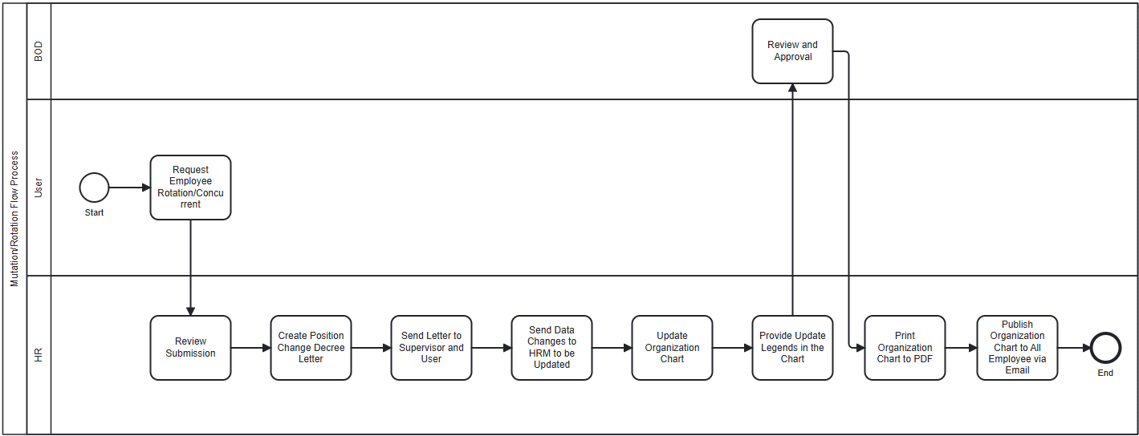
III. Proposed Flow Process
III. Proposed Process Flow – Promotion Evaluation (Cont’d)
Here is the business process of Mutation / Rotation Evaluation:

Slide 35
III. Proposed Flow Process
IV. Proposed Process Flow – Manpower Planning
Here is the business process of Manpower Planning:
There are two kind of MPP, Regular and Incidental
Regular - MPP
Incidental - MPP

Slide 36
III. Proposed Flow Process
IV. Proposed Process Flow – Manpower Planning (Cont’d)
Here is the business process of Manpower Planning:

Slide 37
III. Proposed Flow Process
V. Proposed Process Flow – Job Profiling
Here is the business process of Job Profiling:

Slide 38
III. Proposed Flow Process
VI. Proposed Process Flow – Recruitment
Here is the business process of Recruitment:
*
* Continuing from MPP process A

Slide 39
III. Proposed Flow Process
VI. Proposed Process Flow – Recruitment (Cont’d)
Here is the business process of Onboarding:
*
* Continuing from Recruitment process B

Slide 40
III. Proposed Flow Process
VII. Proposed Process Flow – Training Management
Here is the business process of Training Management:

Slide 41
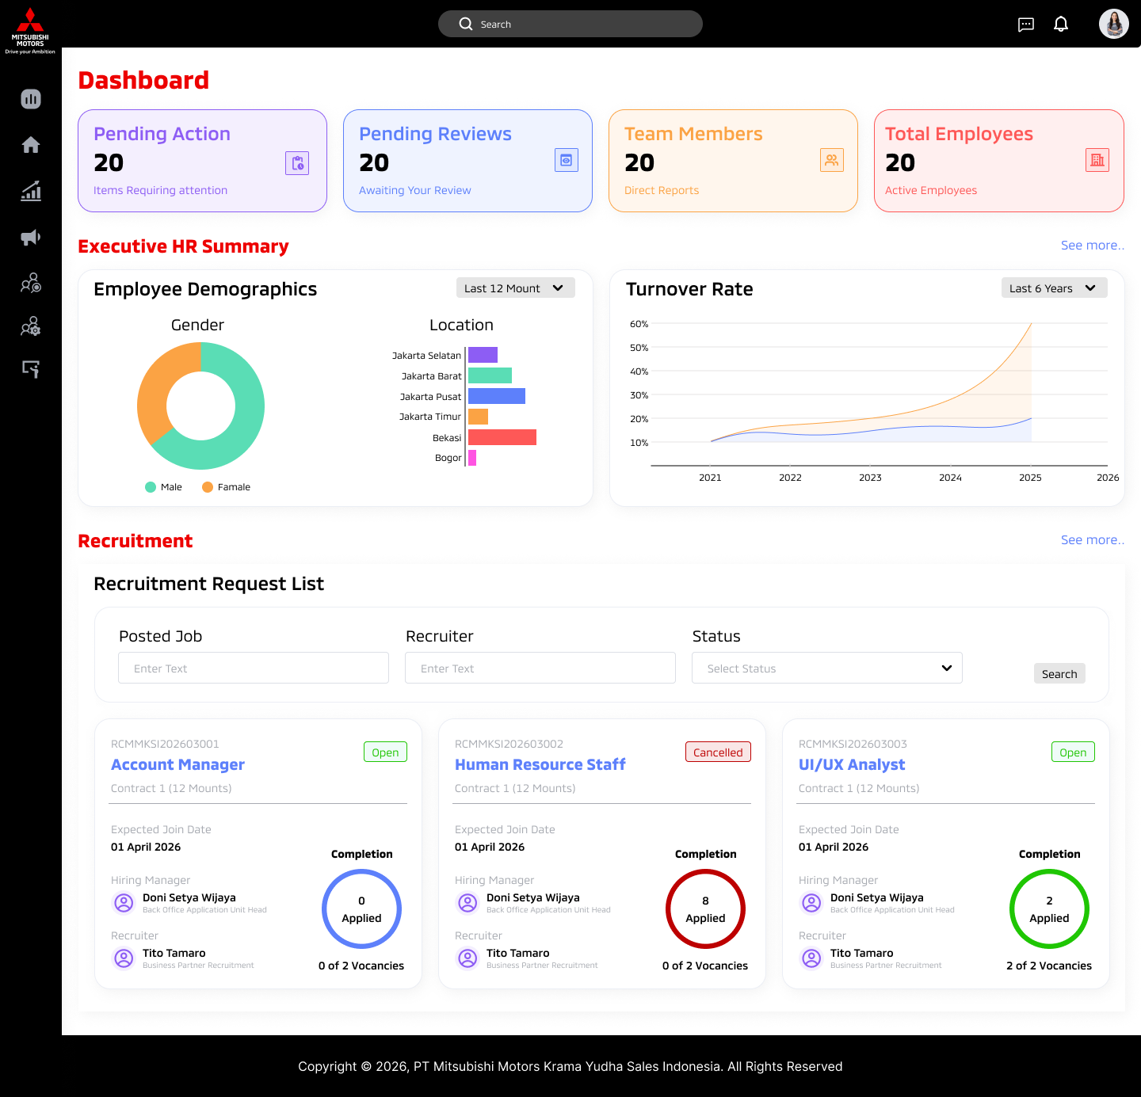
IV. Mockup Sample
I. Mockup Design –
Dashboard

Slide 42
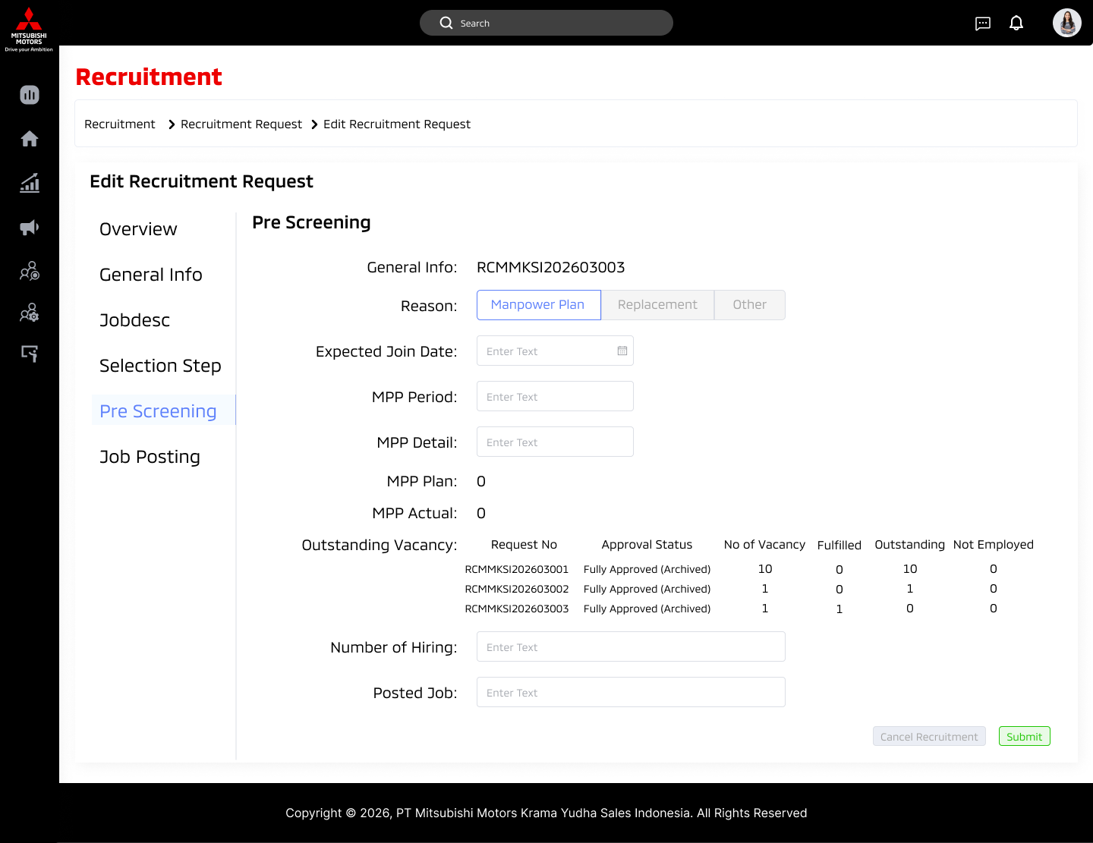
IV. Mockup Sample
II. Mockup Design - Recruitment Module Input

Slide 43
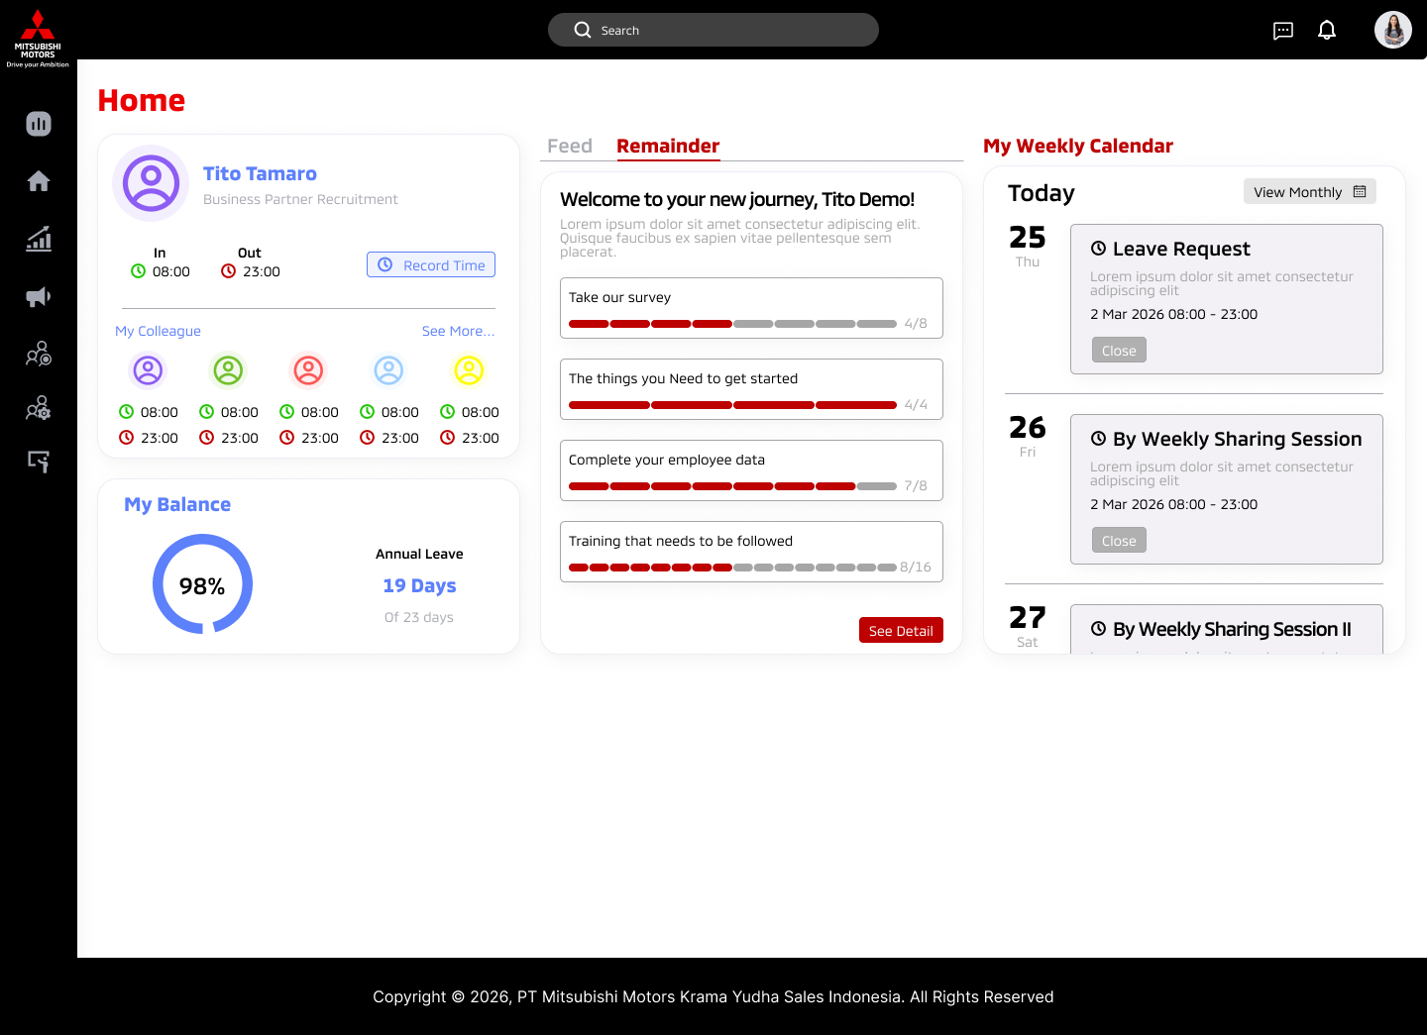
IV. Mockup Sample
III. Mockup Design -
Homepage

Slide 44
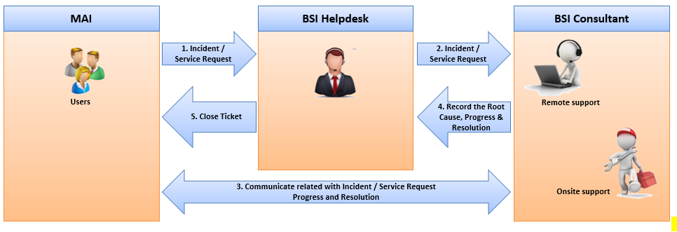
V. Operation Readiness
I. Operation Readiness
No | Activity | Deliverables | Status | Remark
1 | Operation Readiness | Assignment of PIC Operation Support | Completed ● | BSI Operation PIC Operation support for MMKSI will use Ticketing system to record any inquiries, or incident during operation
MMKSI
The incident could be reported via E-mail to Support@bsi.co.id, or
phone number at +6221-47867575.

Slide 45
V. Operation Readiness
II. Support Service Availability
BSI will ensure the Service HRD System Service continuity by providing operation service assistance as follow.
Service Support | 1. Support time is Monday – Friday at 08.00 – 17.00 WIB, except national holidays according to Indonesian government calendar and BSI company policy. For Non-working days and hours support is subject to BSI approval and shall bear overtime; and request notification should be received at least at 04.00 PM one working day before. 2. The incident could be reported via E-mail to Support@bsi.co.id, or phone number at +6221-47867575.
Response time | Maximum response time for incident from BSI consultant to affected user is 60 minutes after user registers its assistance request to BSI’s Helpdesk.
III. System Service Availability
BSI will provide the system availability as follow.
No | Service | System Service Availability | Service Support Availability | Recovery Time Objective
1 | MMKSI Groupware Support | 24 x 7 | 8 x 5 | Refers to SLA
2 | Microsoft Azure Infrastructure • Container Apps • Storage Accounts • Azure Monitor | N/A Refers to Microsoft | N/A Refers to Microsoft | N/A Refers to Microsoft

Slide 46
VI. Pain Point & Propose Solution Details
I. Performance Evaluation & Logbook
Module | Pain Point | Propose solution | Benefit
Performance Evaluation | Unstructured performance evaluation system Misalign employee KPIs with company goals, Unsupported multiple review stages Unable to provide accurate scoring and calibration. | Provide a system function that enable structured and end-to-end Performance Evaluation process starting from individual KPI planning that align with company goals. | Operational efficiency to support Data-driven decisions.
Logbook | Manually input scores in spreadsheets is time-consuming and highly prone to error Hard to track an employee's competency progress Painful compiling process for dozens of individual logbooks into a single department overview No automated remainder for to update the logbook | Implement a centralized Logbook & Competency Management System that enables structured competency tracking, automated data capture, and real-time visibility across employees and departments. | Drive operational efficiency with automated processes, ensure accurate and consistent competency data, and enable real-time insights for faster, more informed decision-making.

Slide 47
VI. Pain Point & Propose Solution Details
II. Promotion
Module | Pain Point | Propose solution | Benefit
Promotion | Time-consuming manual collection of employee data (KPIs, attendance, tenure, past reviews) from multiple spreadsheets and physical files. Lack of standardized criteria often leads to subjective, inconsistent, or biased promotion decisions. No centralized way to track which employees are due or eligible for a promotion evaluation. Difficult to trace the justification, feedback, or historical record of why someone was (or wasn't) promoted. | Centralized data which automatically pulls in real-time employee metrics (performance scores, tenure, attendance) into a single evaluation profile. Pre-configured evaluation templates and scoring rubrics tailored to specific roles or departments. System automatically flags when an employee meets the baseline criteria (e.g., tenure length, KPI threshold) for a promotion review. Secure, digital storage of all past evaluation forms, reviewer comments, and final decisions. | Eliminates hours of manual administrative work and data compilation for the HR team. Data-driven insights ensure promotions are based on merit, reducing bias. Provides a clear, documented audit trail of the entire decision-making process for compliance and employee feedback.

Slide 48
VI. Pain Point & Propose Solution Details
III. Training Management
Module | Pain Point | Propose solution | Benefit
Training Management | Difficult to track employees that need training and its status (who has completed it or when certificates expire) HRD wastes hours manually drafting emails to coordinate training schedules, send invites, and track RSVPs back and forth with employees Hard to map competency gaps for each employee Paper based evaluation translate to hard data entry and scattered training history | Centralized Digital Repository to consolidates all training histories, expired certificates, and attendance records Automated workflows for enrollment, scheduling, and reminder notifications for upcoming training. Linking training modules to the performance evaluation and competency logbooks, automatically suggesting courses based on actual skill gaps. Moves pre-tests, post-tests, and trainer evaluations entirely online, automatically calculating scores and updating the employee's record. | Frees the HRD team from tedious administrative data-chasing so they can focus on strategic talent development and curriculum planning. Real-Time Visibility for overall training effectiveness for employee and management. Provides a self-service portal where employees can proactively view their development plans, request training, and track their own progress. Data-Driven Decisions for company based on documented performance need and organizational goals

Slide 49
VI. Pain Point & Propose Solution Details
IV. Manpower Planning
Module | Pain Point | Propose solution* | Benefit
Manpower Planning | Department heads request new staff through informal channels (emails, chats, paper forms), making it difficult to consolidate and track company-wide needs. Without a forward-looking plan, the HR team is stuck scrambling to backfill roles only after someone resigns, leading to prolonged vacancies. Difficult to instantly visualize which departments are understaffed, overstaffed, or experiencing high turnover. | Standardized MPP request workflow, system-based forms for managers to submit annual or ad-hoc headcount requests, complete with justification fields and automated approval routing. Stores historical turnover and hiring data to help departments forecast future manpower needs more accurately. A centralized view that automatically compares current active employees against the approved manpower plan for the year. | Single Source of Truth - Eliminates messy spreadsheets and ensures HR, Management, and Department Heads are all looking at the exact same data. Prevents accidental over-hiring and ensures critical departments have the exact headcount they need to meet targets. Allows management to quickly adjust manpower plans system-wide if business goals or structures change mid-year.
*) Detail Requirement provided in Appendix.

Slide 50
VI. Pain Point & Propose Solution Details
V. Job Profiling & Recruitment
Module | Pain Point | Propose solution | Benefit
Job Profiling | Without a centralized system, job postings can end up with mismatched fonts, layouts, or branding on the public-facing site. Manually tracking when to take down filled or expired roles is difficult, often leaving outdated jobs on the website and confusing candidates. | Pre-configured posting templates ensure every public-facing job ad automatically aligns with corporate branding guidelines. Features to schedule a post to go live on a specific date and automatically take it down once the application deadline passes or the quota is filled. | Guaranteed Brand Consistency - Ensures a highly professional, uniform look for all open roles, strengthening the employer brand. Automated takedowns guarantee that the public site is always up-to-date, improving the experience for potential applicants.
Recruitment | Disconnected candidate data sources that impacted to potential candidates’ loss Disintegrated recruitment process with other modules in HRIS System Not meet with PDP and company compliance policy. | Implement an integrated recruitment management system that end-to-end hiring process with centralized and real time visibility related to all recruitment data on single platform | Cost efficiency in gaining potential candidates to improve collaboration across stakeholder

Slide 51
VI. Pain Point & Propose Solution Details
VI. Master Data Synchronization
Module | Pain Point | Propose solution | Benefit
Master Data Configuration | Core employee details, department structures, and job titles live in multiple, disconnected Excel spreadsheets across different computers. High risk of mismatched information (e.g., an employee is marked as "active" in one file but "resigned" in another, or job titles are spelled differently). | A centralized, secure database that acts as the ultimate, definitive record for all organizational and employee data. The system automatically pushes master data updates (like a title change) to all other connected HR modules instantly, ensuring uniform data across the board. | Ensures all future modules you build on top (Promotion, Recruitment, Performance) will pull from 100% accurate, real-time data.

Slide 52
Timeline & Main Activities
Month 1 |  |  |  | Month 2 |  |  |  | Month 3 |  |  |  | Month 4 |  |  |  | Month 5
Iteration 1 |  | Iteration 2 |  | Iteration 3 |  | Iteration 4 |  | Iteration 5 |  | Iteration 6 |  | Iteration 7 |  | Iteration 8 |  | Iteration 9 |  | Iteration 10 |  | Iteration 11 |  | Iteration 12 |  | Iteration 13
4- 8 May | 11 – 15 May | 18 – 22 May | 25 – 29 May | 1 – 5 Jun | 8 – 12 Jun | 15 – 19 Jun | 22 – 26 Jun | 29 Jun – 3 Jul | 6 – 10 Jul | 13 – 17 Jul | 20 – 24 Jul | 27 – 31 Jul | 3 – 7 Aug | 10 – 14 Aug | 17 – 21 Aug | 24 – 28 Aug | 31 Aug – 4 Sep | 7 – 11 Sep | 14 – 18 Sep | 21 – 25 Sep | 28 Sep – 2 Oct | 5 –9 Oct | 12 – 16 Oct | 19 – 23 Oct | 26 – 30 Oct
Phase | Iteration | Period | Main Activities | Key Deliverables | Cost Driver
Enabler |  |  | Environment, security setup | Development environment, access authorization, license, all required resources and tools ready to use by Development team | Infra team
Phase 1 | Iteration 1 | 4–8 May 2026 | Iteration Planning #1, Master Data Configuration | Core HR data foundation | SM, PO, PM, Dev Team, Dev Lead, SA, QA
 | Iteration 1 | 11 – 15 May 2026 | Performance Evaluation Development, Iteration Review | Key Function of Performance Evaluation | SM, PO, PM, Dev Team, QA
 | Iteration 2 | 18–22 May 2026 | Iteration Planning, Performance Evaluation Development (cont), Iteration Review | Stable core HR modules | SM, PO, PM, Dev Team, QA
 | Iteration 3 | 25 May – 12 Jun 2026 | Iteration Planning, Master Data Migration, Iteration Review | Validated HR data | Dev Team, Dev Lead, PO, SA
 | Iteration 4 | 15–26 Jun 2026 | Iteration Planning, Training Activity, UAT, Partial Go‑Live | System live for limited users | SM, PM, PMO, PO, Dev Team, QA
Phase 2 | Iteration 5–6 | 29 Jun – 24 Jul 2026 | Iteration Planning, Logbook & Promotion Development, Iteration Review | Promotion workflow | SM, PO, PM, Dev Team, QA
 | Iteration 7–8 | 27 Jul – 21 Aug 2026 | Iteration Planning, Training Management Development, Iteration Review | Training lifecycle | SM, PO, PM, Dev Team, QA
 | Iteration 9–10 | 24 Aug – 18 Sep 2026 | Iteration Planning, MPP Development, Iteration Review | Workforce planning | SM, PO, PM, Dev Team, QA
 | Iteration 11–12 | 21 Sep – 16 Oct 2026 | Iteration Planning, Recruitment Development, Iteration Review | Recruitment process | SM, PO, PM, Dev Team, QA
 | Iteration 13 | 19 Oct – 30 Oct 2026 | VAPT and remediation | All of findings is solved | SM, PM, Dev Team, Dev team lead, SA
 | Iteration 14 | 2 Nov – 6 Nov 2026 | Training | Training for Key User for Phase 2 and will involving training with end user | SM, PM, PMO, PO, Dev Team, QA
 |  | 9 Nov – 13 Nov 2026 | Full Go Live | Signoff UAT, CAB, Deployment plan, Deployment execution, Publish web application, testing & resolution after deployment | SM, PM, PO, Dev Team, Dev team lead, SA
If frequent partial go-lives are required to allow users to utilize certain modules earlier, additional phases will be necessary. Each phase will require an additional one or two week for training and preparation.

Slide 53
VII. Detail iteration activities
Timeline Phase 1
May 2026 |  |  |  | June 2026
Iteration 1 |  | Iteration 2 |  | Iteration 3 |  | Iteration 4
4 – 8 May | 11 – 15 May | 18 – 22 May | 25 – 29 May | 1 – 5 Jun | 8 – 12 Jun | 15 – 19 Jun | 22 – 26 Jun
Iteration Planning #1 SM, PO, PM, Dev Team, Dev Lead, SA, QA Master Data Configuration Dev Team, Dev Lead, PO, SA | Iteration Review SM, PO, PM, QA | Iteration Planning #2 SM, PO, PM, Dev Team, Dev Lead, SA, QA | Iteration Review + Demo SM, PO, PM, QA, Key Users | Iteration Planning #3 SM, PO, PM, Dev Team, Dev Lead, SA, QA | Iteration Review + Demo SM, PO, PM, QA, Key Users | Training Activity PM, PMO Iteration Planning #4 SM, PO, PM, Dev Team, Dev Lead, SA, QA UAT PO, QA, Key Users, SM, Dev Team | Partial Go Live Phase 1 All
Development + SIT: Performance Evaluation
SM, PO, PM, Dev Team, Dev Lead, SA, QA
Master Data Migration
Dev Team, Dev Lead, PO, SA

Slide 54
VII. Detail iteration activities
Timeline Phase 2 (1)
July 2026 |  |  |  | Jul-August 2026
Iteration 5 |  | Iteration 6 |  | Iteration 7 |  | Iteration 8
29 Jun – 3 Jul | 6 – 10 Jul | 13 – 17 Jul | 20 – 24 Jul | 27 – 31 Jul | 3 – 7 Aug | 10 – 14 Aug | 17 – 21 Aug
Iteration Planning #5 SM, PO, PM, Dev Team, Dev Lead, SA, QA | Iteration Review + Demo SM, PO, PM, QA, Key Users | Iteration Planning #6 SM, PO, PM, Dev Team, Dev Lead, SA, QA | Iteration Review + Demo SM, PO, PM, QA, Key Users | Iteration Planning #7 SM, PO, PM, Dev Team, Dev Lead, SA, QA | Iteration Review + Demo SM, PO, PM, QA, Key Users | Iteration Planning #8 SM, PO, PM, Dev Team, Dev Lead, SA, QA | Iteration Review + Demo SM, PO, PM, QA, Key Users
Development + SIT: Logbook Promotion
SM, PO, PM, Dev Team, Dev Lead, SA, QA
Development + SIT: Training Management
SM, PO, PM, Dev Team, Dev Lead, SA, QA

Slide 55
VII. Detail iteration activities
Timeline Phase 2 (2)
Aug-Sept 2026 |  |  |  | Sep-Oct 2026
Iteration 9 |  | Iteration 10 |  | Iteration 11 |  | Iteration 12
24 – 28 Aug | 31 Aug – 4 Sep | 7 – 11 Sep | 14 – 18 Sep | 21 – 25 Sep | 28 Sep – 2 Oct | 5 – 9 Oct | 12 – 16 Oct
Iteration Planning #9 SM, PO, PM, Dev Team, Dev Lead, SA, QA | Iteration Review + Demo SM, PO, PM, QA, Key Users | Iteration Planning #10 SM, PO, PM, Dev Team, Dev Lead, SA, QA | Iteration Review + Demo SM, PO, PM, QA, Key Users | Iteration Planning #11 SM, PO, PM, Dev Team, Dev Lead, SA, QA | Iteration Review + Demo SM, PO, PM, QA, Key Users | Iteration Planning #12 SM, PO, PM, Dev Team, Dev Lead, SA, QA | Iteration Review + Demo SM, PO, PM, QA, Key Users
Development + SIT: MPP
SM, PO, PM, Dev Team, Dev Lead, SA, QA
Development + SIT: Recruitment
SM, PO, PM, Dev Team, Dev Lead, SA, QA

Slide 56
VII. Detail iteration activities
Timeline Phase 2 (3)
Oct-Nov 2026
Iteration 13 |  | Iteration 14
19 – 23 Oct | 26 – 30 Oct | 2 – 6 Nov | 9 – 13 Nov
VAPT | VAPT | Training | Full Go Live All

Slide 57
Role, Accountabilities & Responsibilities
Project Manager
Accountabilities:
Delivery project sesuai scope, timeline, budget
Manajemen risiko dan dependensi
Stakeholder alignment
Responsibilities:
Membuat dan mengelola project plan
Monitoring progress and reporting
Managing risk and issue log
Koordinasi lintas tim
Escalation management
Product Manager (PM)
Accountabilities:
Kesuksesan produk secara end-to-end (business value)
Product vision & strategy
Responsibilities:
Membuat product roadmap
Menentukan prioritas fitur (value-driven)
Market & user research
Stakeholder business alignment

Slide 58
Role | Accountability | Responsibility
Project Manager | Project deliverable on scope , timeline and budget Risk management and dependency Stakeholder alignment

Slide 59
Role, Accountabilities & Responsibilities
PMO
Accountabilities:
Governance & standardisasi project delivery
Konsistensi metodologi & reporting
Responsibilities:
Menyusun template & framework project
Monitoring portfolio project
Reporting ke management
Audit & compliance project
Support tools & best practices
Scrum Master (SM)
Accountabilities:
Menjaga implementasi Agile/Scrum berjalan efektif
Memastikan tim mencapai continuous improvement
Menghilangkan hambatan (impediments) tim
Responsibiliies:
Memfasilitasi Scrum events (Daily, Sprint Planning, Review, Retrospective)
Coaching tim terkait Agile mindset
Melindungi tim dari gangguan eksternal
Membantu stakeholder memahami Scrum
Tracking dan improving team velocity

Slide 60
Role, Accountabilities & Responsibilities
Product Owner (PO)
Accountabilities:
Maximizing value dari product backlog
Kejelasan requirement untuk tim
Responsibilities:
Mengelola dan memprioritaskan backlog
Menulis user stories & acceptance criteria
Berkolaborasi dengan tim dev
Accept/reject hasil kerja tim
Clarify requirement harian
Dev Lead
Accountabilities:
Kualitas teknis dan delivery tim development
Keputusan teknis di level tim
Responsibilities:
Membantu Solution Architect (SA) dalam Code review
Mentoring developer
Mendesain solusi teknis (detail level)

Slide 61
Role, Accountabilities & Responsibilities
Solution Architect (SA)
Accountabilities:
Arsitektur sistem secara keseluruhan
Scalability, security, dan integrasi sistem
Responsibilities:
Mendesain high-level architecture
Menentukan teknologi & framework
Alignment dengan business & IT strategy
Review code dan solusi teknis dari tim dev
Menjaga compliance arsitektur
Quality Assurance (QA)
Accountabililities:
Kualitas produk sebelum release
Memastikan sistem sesuai requirement
Responsibilities:
Membuat test plan & test case
Melakukan testing (manual/automation)
Bug tracking & reporting
Validasi terhadap acceptance criteria
Regression testing sebelum release

Slide 62
Role, Accountabilities & Responsibilities
Development Team
Accountabilities:
Deliver increment produk yang siap digunakan (potentially shippable) setiap sprint
Menjaga kualitas teknis dan fungsional dari hasil development
Komitmen terhadap Sprint Goal
Responsibilities:
Mengembangkan fitur sesuai user story & acceptance criteria
Melakukan coding, unit testing, dan integrasi
Berkolaborasi dengan Product Owner untuk klarifikasi requirement
Berpartisipasi aktif dalam semua Scrum events
Melakukan estimasi pekerjaan (story points / effort)
Menjaga kualitas code (clean code, standard, best practices)
Fix bug dan melakukan perbaikan berkelanjutan
Mendokumentasikan aspek teknis jika diperlukan

Slide 63
Hidden Slides

Slide 64
1. Executive Summary
1.1 Background
Currently MMKSI is using their HRIS system to do HRD daily operation; however, the system is underutilized due to usability issues and misalignment with actual HRD operational needs. The complexity of the system has resulted in low user adoption, manual workarounds, and limited return on investment.
To address these challenges, MMKSI has appointed BSI to implement a more effective, intuitive, and business-aligned HRD solution that better supports daily HR operations and future organizational growth.
1.2 Objective
Align system capabilities with actual HRD workflows, functional requirements, and strategic goals.
Drive user adoption by implementing an intuitive and user-friendly HRD platform.
Ensure seamless provisioning and transition from the existing underutilized system to the new solution.
1.3 Benefit
Maximized system utilization resulting in higher return on technology investment.
Increased operational efficiency through streamlined HRD processes and reduced manual work.
Enhanced user experience with a simplified interface and shorter learning curve.
1.4 Commercial Overview
Implementation Fee (IDR) : Operation Fee (IDR) :

Slide 65
1. Executive Summary
1.1 Background
Currently, MMKSI’s performance evaluation process is largely managed using Excel, covering form creation, evaluation execution, and result aggregation. This manual approach leads to inefficiencies, high administrative effort, and challenges in maintaining data consistency.
In addition, performance evaluation methods frequently change following management direction, creating a need for a system that is flexible and can adapt without requiring significant redevelopment effort and cost.
While several options are being considered, including a simplified dashboard approach, the current direction is leaning toward implementing a dedicated system that can support a more structured, scalable, and sustainable HR process.
Therefore, MMKSI requires a solution that not only digitizes the current process but also provides flexibility, integration, and long-term efficiency for HR operations.

Slide 66
1. Executive Summary
1.2 Objective
Digitize and streamline the current Excel-based HR processes into a centralized system
Provide a flexible and configurable system that can adapt to changing evaluation methods
Reduce manual effort and administrative workload in HR operations
Establish a scalable and sustainable HR system to support long-term business needs
1.3 Benefit
Reduced dependency on manual Excel processes, improving efficiency and accuracy
Lower long-term cost and effort through a configurable and adaptable system
Consistent and reliable HR data as a single source of truth
Improved process control and visibility across evaluation and HR activities
Scalable solution that supports future organizational changes
1.4 Commercial Overview
Implementation Fee (IDR) : 1,913,575,000 Operation Fee (IDR) : 270,000,000

Slide 67
2. Requirement & Propose Solution
2.1. Functional Requirement
BSI proposes the implementation of a new HRD system designed with a strong focus on usability, process alignment, and scalability. The solution will be configured based on validated HRD requirements and best practices to ensure long-term value and adaptability.
Module | Requirement | Propose solution | Feature
Performance Evaluation | The HR Department requires a structured and performance evaluation system that aligns employee KPIs with company goals, supports multiple review stages, and enables accurate scoring and calibration. | The system provides a configurable multi-stage performance evaluation with KPI libraries, weighted scoring, supervisor mapping, revision handling, and calibration-adjusted results aligned to organizational goals. | • Planning, Mid-Year, End-Year evaluation stages • KPI bank per job position • KPI weighting & scoring logic • Multiple & concurrent supervisors • Revision & calibration mechanism
Logbook | The HR Department needs a logbook and competency tracking system to monitor employee development, managerial performance, and assessment results in a structured and visible manner. | The system delivers a configurable logbook integrated with a competency dictionary, proficiency levels, evaluator assignment, and assessment result integration within employee profiles. | • Adjustable logbook forms • Competency dictionary with proficiency levels • Evaluator mapping via org structure • Assessment center result integration • Managerial-level visibility
Promotion Evaluation | The HR Department requires a data-driven promotion evaluation process that objectively assesses employee readiness using consolidated performance, training, and attendance data. | The system consolidates HR data into an automated promotion evaluation that calculates eligibility, supports evaluation input, and updates approved career movements. | • Promotion regulation-based rules • Consolidated evaluation data • Automated scoring calculation • Promotion & rotation history tracking • Automatic org structure update

Slide 68
2. Requirement & Propose Solution
2.1. Functional Requirement
Module | Requirement | Propose solution | Feature
Manpower Planning (MPP) | The HR Department needs a controlled and transparent manpower planning process with clear approval governance up to BOD level to ensure workforce plans align with business needs. | The system provides configurable manpower planning workflows with role-based access, multi-level approvals up to BOD, real-time tracking dashboards, and audit trails. | • Regular & incidental MPP requests • Configurable approval workflows • BOD authorization control • Real-time request dashboard • Revision, rejection & notification handling
Job Profiling | The HR Department requires standardized job definitions and vacancy creation processes that are fully aligned with approved manpower plans. | The system enforces standardized job description and requirement creation tightly integrated with approved manpower plans to prevent unauthorized vacancies. | • Job Description & Requirement templates • MPP-linked vacancy control • Audit trail for job changes • Secure approval prior to recruitment • Secure login for candidate authentication
Recruitment | The HR Department needs an end-to-end recruitment system that ensures an efficient, transparent, and accountable hiring process from application to onboarding approval. | The system delivers a workflow-based recruitment and ATS platform covering candidate applications, assessments, interviews, approvals, medical checks, onboarding preparation, and probation tracking. | • Candidate portal & ATS tracking • Online tests & interviews • Medical check (MCU) management • BOD offer approval workflow • Probation & first-month evaluation

Slide 69
2. Requirement & Propose Solution
2.1. Functional Requirement
Module | Requirement | Propose solution | Feature
Training Management | The HR Department requires an integrated training management system to ensure employee development is driven by performance gaps, talent movement, and organizational capability needs. | The system integrates training needs from evaluations, logbooks, and talent movement into structured training plans with approval, execution, evaluation, and completion tracking. | • Training Need Analysis (TNA) • Training request & approval flow • Training attendance & completion • Evaluation & knowledge sharing • Individual development plans
Core | The HR Department needs a reliable core HR platform that supports bulk data management, approval workflows, and timely communication to improve operational efficiency. | The system provides centralized employee data management, bulk upload capabilities, configurable approvals, dashboards, and automated notifications via email and WhatsApp. | • Bulk data upload (CRUD) • Role-based access & approvals • Centralized employee master data • Email & WhatsApp notifications • HR operational dashboards

Slide 70
3. Project Methodology
3.1. General Overview
BSI proposes implementing the HRD System using an Agile delivery framework to ensure flexibility, faster value realization, and continuous alignment with MMKSI’s HRD operational needs.
The Agile approach enables the project to be delivered through incremental, module-based releases, where each module is implemented, tested, and released based on its business priority. This allows MMKSI to begin utilizing critical HRD functionalities earlier while subsequent modules are refined and delivered progressively.
3.2 Agile Framework Overview
The project will be executed in iterative cycles (Sprints), with each Sprint producing a usable and testable system component. Continuous collaboration between MMKSI and BSI will be maintained throughout the project lifecycle to ensure requirements are clearly understood and validated.
Core principles applied in this Agile implementation include:
Incremental delivery based on module priority
Continuous user feedback and validation
Early visibility of system functionality
Flexibility to accommodate evolving HRD requirements
Controlled governance through structured Agile ceremonies

Slide 71
3. Project Methodology
3.3 Module-Based Release Strategy
The HRD System will be released by functional module, following a priority order agreed upon jointly by MMKSI and BSI during the project initiation phase.
The indicative module release priority is as follows:
Phase 1 Go Live:
Core HR & Employee Master Data
Performance Evaluation
Phase 2 Go Live:
Promotion Evaluation
Logbook
Training Management
Manpower Planning (MPP)
Recruitment

Slide 72
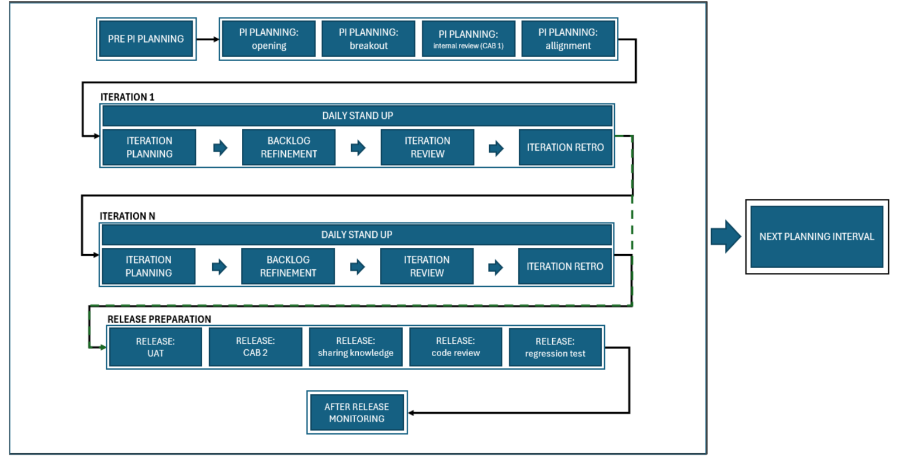
3. Project Methodology
3.2. Project Event

Slide 73
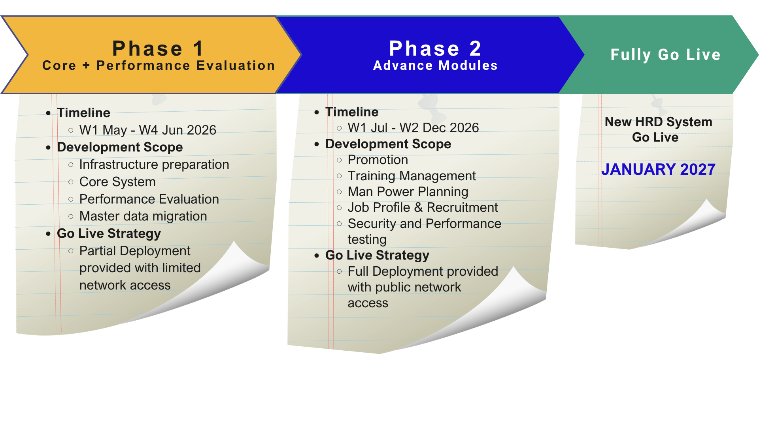
3. Project Methodology
3.2 Project Phase
The project phase outlines the key timeline and milestones for successful completion.
Notes:
Core system vs Master Data Configuration PE VS PMS ?
Footnotes: Each phase will have several iteration Agile event for user’s involvement should be included in

Slide 74
3. Project Methodology
3.3 Project Phase/Timeline
The project phase outlines the key timeline and milestones for successful completion.
Phase 1 (W1 May – W4 July)
Process | W1-W2 May | W3-W4 May | W1-W2 Jun | W3-W4 Jun | W1-W2 Jul | W3-W4 Jul
 | Iteration 1 | Iteration 2 | Iteration 3 | Iteration 4 | Iteration 5 | Iteration 6
Kick Off
Requirement Finalization
Server/Infra Preparation
Development
Master Data & Configuration
Performance Management System
Data Migration
SIT
UAT
Go Live Phase 1
Notes:
Core system vs Master Data Configuration PE VS PMS ?
Footnotes: Each phase will have several iteration Agile event for user’s involvement should be included in

Slide 75
3. Project Methodology
3.3 Project Phase/Timeline
The project phase outlines the key timeline and milestones for successful completion.
Apr 26 | May 26 | Jun 26 | Jul 26 | Aug 26 | Sep 26 | Oct 26 | Nov 26 | Dec 26
Enabler
Development Iteration
Development 1st Backlogs :
Master Data configuration
Performance Evaluation
Master data migration
Development 2nd Backlogs:
Man-Power Planning (MPP)
Recruitment
Development 3rd Backlogs:
Promotion Evaluation
Development 4th Backlogs: Training Management
Partial Go Live 1 (W4 Jun 26)
Full Go-Live (W2 Dec 26)
Enabler activities : 1. Prepare development environment
2. Resources procurement
This timeline can be more shorten or become longer, depends on scope items review result on each iteration time (2 Weeks). ​
Any adjustment on scope or priority based on MMKSI request is welcome on the agile methods.​
MMKSI will review product backlog incremental progress through iteration demo meeting every biweekly.​
MMKSI will take decision whether the improvement from iteration review (demo) will be released per iteration or not (partially released) and it will always continue with Review (PDCA) activity.​
PDCA review must be conducted during operation after partial 1st go live.
Every new potential improvement (output from PDCA Result) can be put as additional product backlog and put on development chain activity based on decision from MMKSI to absorb it or not.​

Slide 76
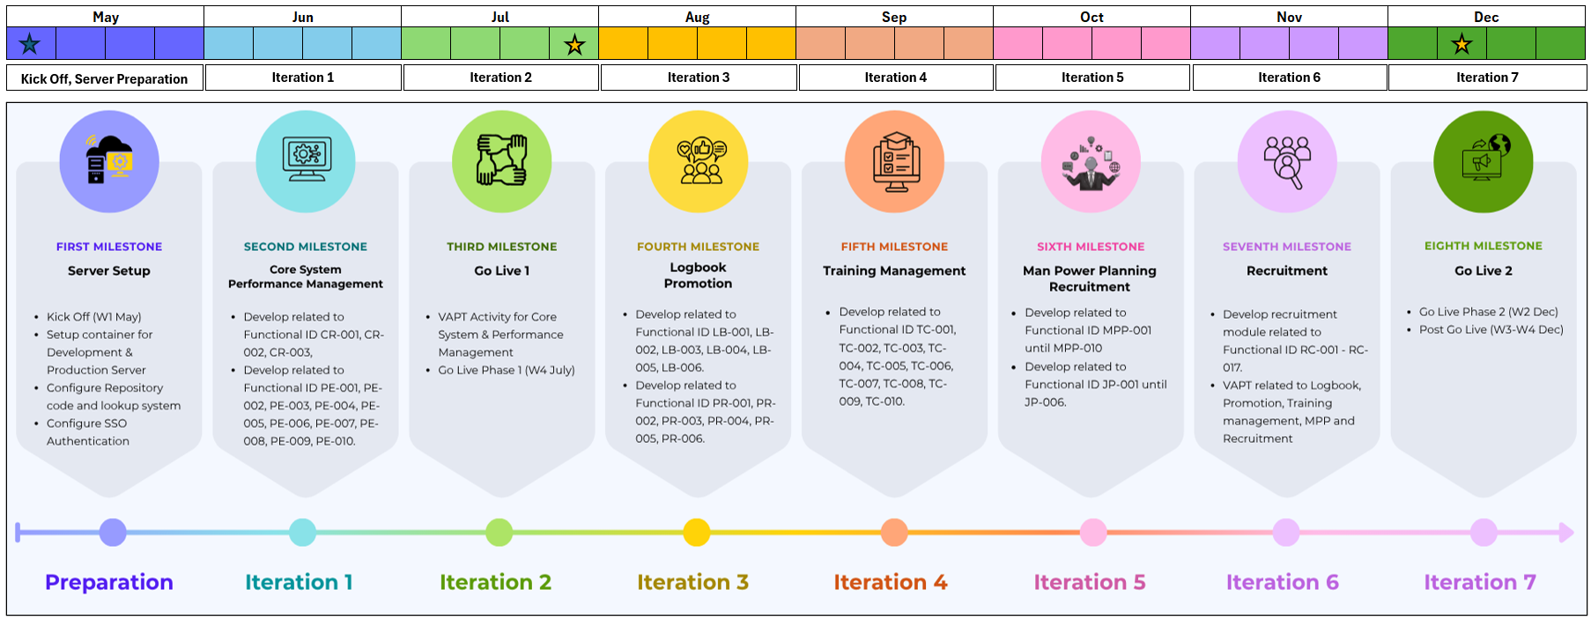
5. Timeline
5.1 Timeline
The project is estimated to be completed within 32 weeks, structured as follows:

Slide 77
6. Commercial
6.2. Operation Fee
Below is the summary of effort estimation that is required in Operation & Maintenance (O&M) after each GoLive.
If the project schedule is changed due to any reasons, the estimation can be changed accordingly.
No​ | Service Name​ | HR Operation Amount FY26 (in Mio IDR) |  |  |  |  |  |  |  |  |  |  |  | (FY27)​
 |  | May’​ 26 | Jun’​ 26 | Jul’ ​ 26 | Aug’​ 26 | Sep’​ 26 | Oct’​ 26 | Nov’​ 26 | Dec’​ 26 | Jan’​ 27 | Feb’​ 27 | Mar’​ 27 | Total​ | Monthly​
Milestone​ |  | ​ | ​ | ​ | ​ | ​ | ​ | ​ | ​ | ​ | ​ | ​ | ​ | ​
1​ | Existing ​HRIS O&M HR & SW Cloud | 42.4 15.04 | 42.4 15.04 | 43.73 15.04 | 43.73 15.04 | 43.73 15.04 | 43.73 15.04 | 43.73 15.04 | 43.73 15.04 | 43.73 15.04 | 43.73 15.04 | 43.73 15.04 | 478.37 165.44 | 44.48​ 15.04
2​ | New HRD O&M (HR) | 0​ | 0​ | 0​ | 0​ | 9 | 9 | 9 | 9 | 22.5 | 22.5 | 22.5 | 103.5 | 22.5
Total Amount Estimation​ |  | 57.44 | 57.44 | 58.77 | 58.77​ | 67.77 | 67.77 | 67.77 | 67.77 | 81.27 | 81.27 | 81.27 | 747.31 | 82.02
Go-Live 1
Go-Live 2
Terms and Condition
Prices are in Indonesian Rupiah (IDR) and exclude VAT
This operation service shall be started after first Go Live is being released
Above price table is refer to defined scope of service in Appendix - V
Service period for HRIS Managed Service is 1 year starting from go live date. If MMKSI terminates the Service before the end of the Service Period, MMKSI shall compensate BSI in amount of remaining Service Period left.
Any additional scope of work that is not stated in this document will be charged in separate invoice based on relevant supporting document.

Slide 78
May |  |  |  | June
Iteration 1 |  | Iteration 2 |  | Iteration 3 |  | Iteration 4 |  | Iteration 5
4- 8 May | 11 – 15 May | 18 – 22 May | 25 – 29 May | 1 – 5 Jun | 8 – 12 Jun | 15 – 19 Jun | 22 – 26 Jun | 29 Jun – 3 Jul | 6 – 10 Jul
Phase | Iteration | Period | Main Activities | Key Deliverables | Role Involve | Cost Driver | Cost
Enabler |  |  | Environment, security setup |  | Infra team | One‑time setup – mandatory foundation cost to avoid rework & security exposure | BSI Cost: Developer cost:
Phase 1 | Iteration 1 | 4–8 May 2026 | Iteration Planning #1, Master Data Configuration | Core HR data foundation | SM, PO, PM, Dev Team, Dev Lead, SA, QA | High man‑days at senior roles – core design & data foundation | BSI Cost: Developer Cost:
 | Iteration 2 | 11–22 May 2026 | Development & SIT Performance Evaluation, Iteration Review | Stable core HR modules | SM, PO, PM, Dev Team, QA, HR Key Users | Development + testing effort – quality stabilization cost
 | Iteration 3 | 25 May – 12 Jun 2026 | Master Data Migration | Validated HR data | Dev Team, Dev Lead, PO, SA | Data validation & rework prevention – labor‑intensive accuracy assurance
 | Iteration 4 | 15–26 Jun 2026 | Training Activity, Partial Go‑Live | System live for limited users | PM, PMO, Key Users | Parallel development & operation – double running cost
Phase 2 | Iteration 5–6 | 29 Jun – 24 Jul 2026 | Logbook & Promotion Development | Promotion workflow | SM, PO, PM, | Workflow complexity & multi‑approval logic
 | Iteration 7–8 | 27 Jul – 21 Aug 2026 | Training Management Development | Training lifecycle |  | End‑to‑end process setup – lifecycle testing
 | Iteration 9–10 | 24 Aug – 18 Sep 2026 | MPP Development | Workforce planning |  | Strategic planning logic & data dependency
 | Iteration 11–12 | 21 Sep – 16 Oct 2026 | Recruitment Development | Recruitment process |  | Multi‑stage approval & compliance controls
 | Iteration 13
 | Iteration 14

